Slide 1
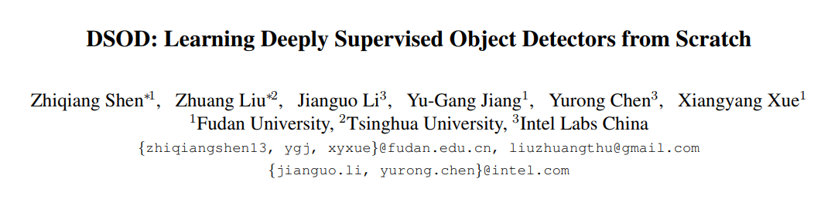
Presented at ICCV 2017
Yu Hsiang Cheng

Slide 2
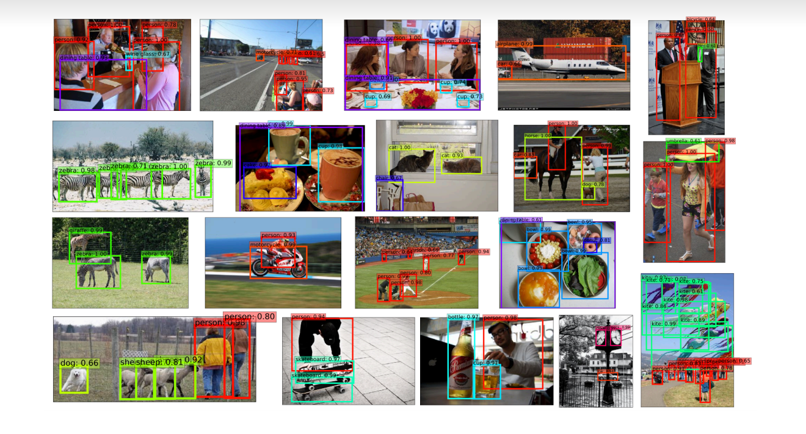
outline

Slide 3
Abstract
Train detection model from scratch.
State-of-the-art object objectors rely heavily on the off-the-shelf networks pre-trained on large-scale classification datasets like ImageNet, which incurs learning bias due to the difference on both the loss functions and the category distributions between classification and detection tasks.

Slide 4
Abstract
Model fine-tuning for the detection task could alleviate this bias to some extent but not fundamentally.
transferring pre-trained models from classification to detection between discrepant domains is even more difficult (RGB to depth images)
A better solution to tackle these two critical problems is to train object detectors from scratch.

Slide 5
Abstract
Previous efforts in this direction mostly failed due to much more complicated loss functions and limited training data in object detection.
we contribute a set of design principles for training object detectors from scratch.
One of the key findings is that deep supervision, enabled by dense layer-wise connections, plays a critical role in learning a good detector.

Slide 6
introduction
CNN network structures have been proposed.
Szegedy et al. [32] propose an “Inception” module which concatenates features maps produced by various sized filters. (Google net)
He et al. [9] propose residual learning blocks with skip connections, which enable training very deep networks with more than 100 layers. (Residual net)
Huang et al. [10] propose DenseNets with dense layer-wise connections. (DenseNet)

Slide 7
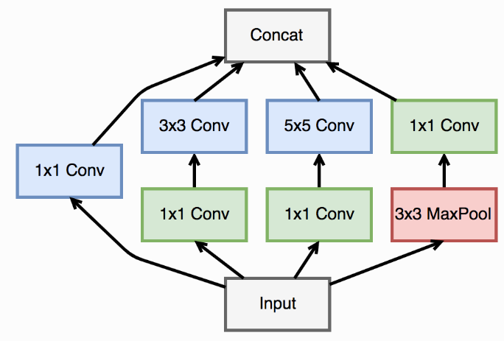
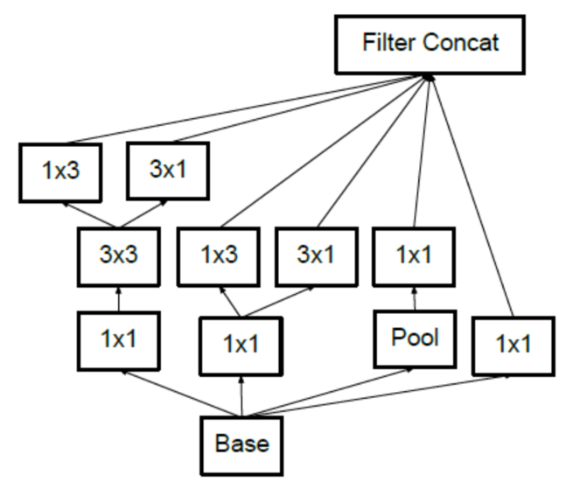
Inception net (google net)
35x35x320
concat
35x35x320
35x35x320
conv
pool
35x35x320

Slide 8
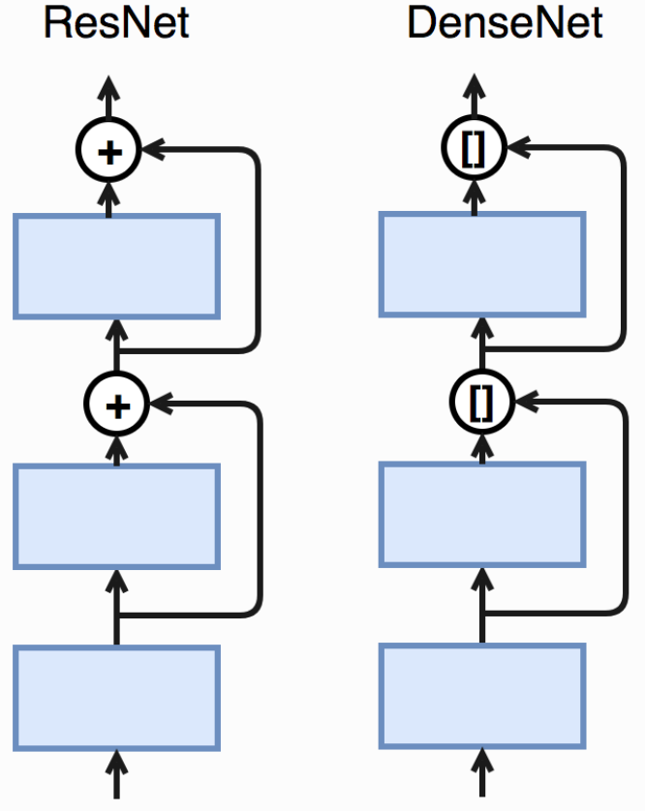
ResNet and DenseNet
Thanks to these excellent network structures, the
accuracy of many vision tasks has been greatly
improved.

Slide 9
introduction
In order to achieve good performance, most of the advanced object detection systems fine-tune networks pretrained on ImageNet [3]. This fine-tuning process is also viewed as transfer learning

Slide 10
Fine-tuning
Fine-tuning from pretrained models has at least two advantages:
there are many state-of-the-art deep models publicly available. It is very convenient to reuse them for object detection
fine-tuning can quickly generate the final model and requires much less instance-level annotated training data than the classification task.

Slide 11
Critical limitations
Critical limitations when adopting the pre-trained networks in object detection
Limited structure design space:
Existing object detectors directly adopt the pre-trained networks, and as a result there is little flexibility to control/adjust the network structures (even for small changes of network structure).
The requirement of computing resources is also bounded by the heavy network structure.
Learing bias:
As both the loss functions and the category distributions between classification and detection tasks are different, we argue that this will lead to different searching/optimization spaces.
Domain mismatch
fine-tuning can mitigate the gap due to different target category distribution. However, it is still a severe problem when the source domain (ImageNet) has a huge mismatch to the target domain such as depth images, medical images

Slide 12
motivation
Our work is motivated by the following two questions.
First, is it possible to train object detection networks from scratch?
Second, if the first answer is positive, are there any principles to design a resource efficient network structure for object detection while keeping high detection accuracy?
To meet this goal, we propose deeply supervised objection detectors (DSOD),

Slide 13
contribute a set of principles for designing DSOD. One key point is that deep supervision plays a critical role, which is motivated by the work of [18, 35]. In [35], Xie et al. proposed a holistically-nested structure for edge detection, which included the side-output layers to each convstage of base network for explicit deep supervision.
this paper adopts deep supervision implicitly through the dense layer-wise connections proposed in DenseNet [10]. Dense structures are not only adopted in the backbone sub-network, but also in the front-end multi-scale prediction layers.

Slide 14
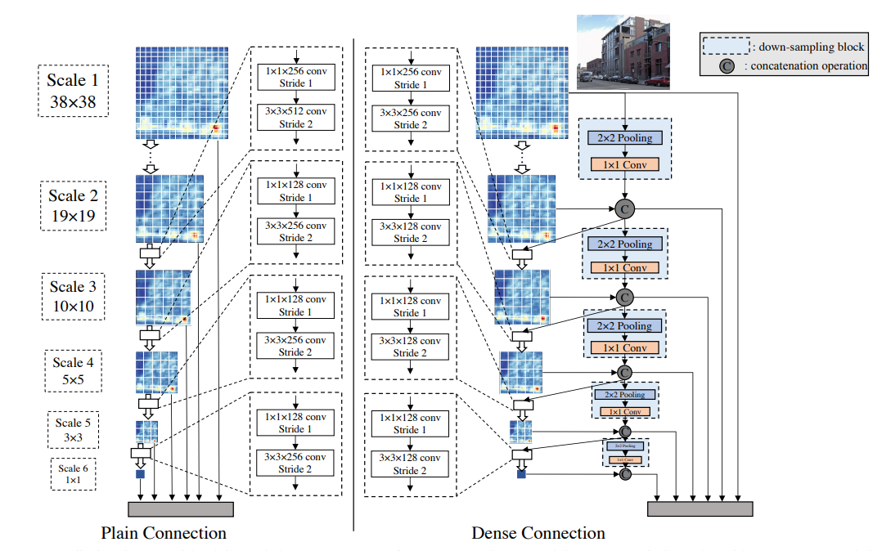
SSD vs DSOD
Main contribution:
1.Train object detection network
from scratch .
2.Introduce and validate a set of
principles to design efficient object
detection networks from scratch
through step by step ablation studies.
3.Show that DSOD can achieve state
of the art detection model.

Slide 15
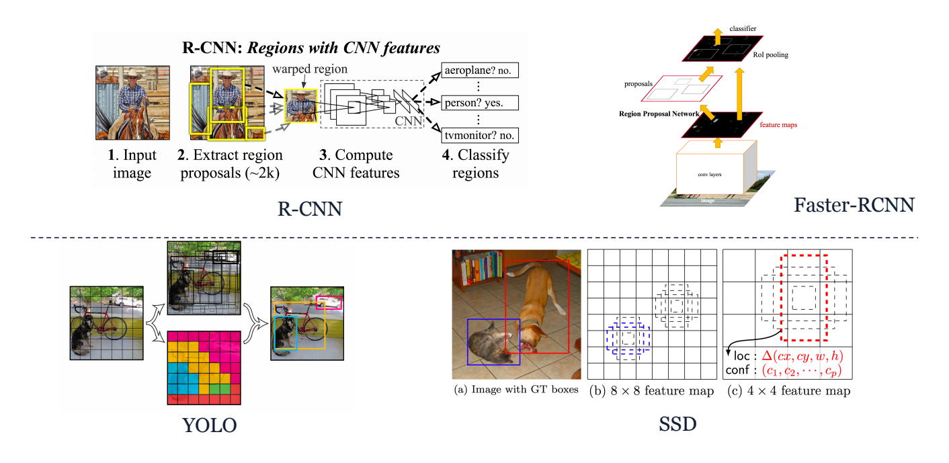
Related work
Proposal based
Proposal-free

Slide 16
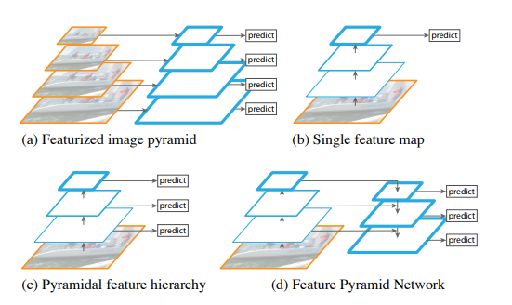
Featurized image pyramid

Slide 17
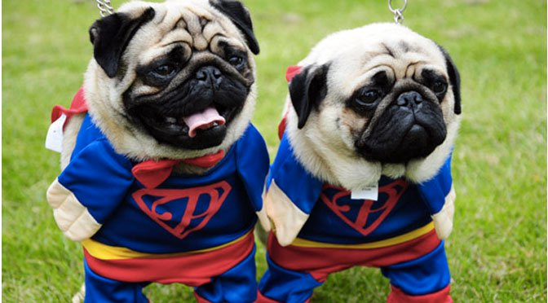
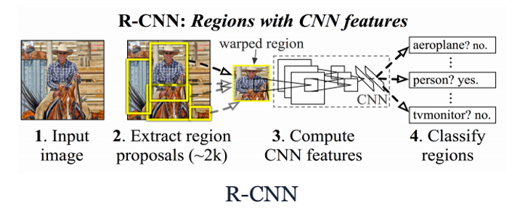
R-CNN
Selective search
Uses selective search to first generate potential object regions in an image and then perform classification on the proposed regions
resize
resize
Convs
Convs
SVM
BBOX
SVM
BBOX

Slide 18
Single feature map

Slide 19
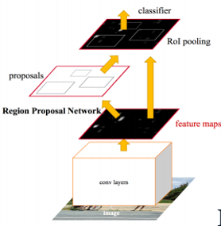
fastRCNN
Convs
Different shape
ROI Pooling
ROI Pooing
output
Dense
Num_Regions x Num_channels x n x m
softmax
BoxReg
50 | 34 | 34 | 26
32 | 78 | 19 | 73
23 | 34 | 23 | 32
34 | 56 | 56 | 78
(0,1),(3,3)
78 | 73
56 | 78
Runtime dominated by
region proposals(inference)
Notes:
Imporve Convs
may decrease ac
Roi pooling vs maxpooling
Increase resolution
Cut evenly

Slide 20
fasterRCNN
RPN(region proposal net):
Background or foreground ?
Convs
1.RPN(SS)
Resample
Pixel and feature for each bounding box
ROI Pooling
Dense
Convs
softmax
BoxReg
BoxReg
softmax
refine
class
Back ground?
Notes:
Replace selective search
RPN foreground or background

Slide 21
RPN
RPN(region proposal net):
Background or foreground ?
VGG(ZF) channels=512
CONV (kernel =3 ,padding = 1 ,channels= 512)
Vgg or zf
1x1
1x1
Convs
Cls ( 2 (back or foreground) * 9 anchor)
18
Boxreg(4 (coord)* 9 )
36
BoxReg
softmax
Back ground?
Notes:
Select search most background

Slide 22
Proposal free <- evolution from RPN
YOLO uses a single feed-forward convolutional network to directly predict object classes and locations. Comparing with the region-based methods, YOLO no longer requires a second per-region classification operation so that it is extremely fast
SSD improves YOLO in several aspects, including
(1) using small convolutional filters to predict categories and anchor offsets for bounding box locations;
(2) using pyramid features for prediction at different scales;
(3) using default boxes and aspect ratios for adjusting varying object shapes.
Our proposed DSOD is built upon the SSD framework and thus it inherits the speed and accuracy
advantages of SSD, while produces smaller and more flexible models.

Slide 23
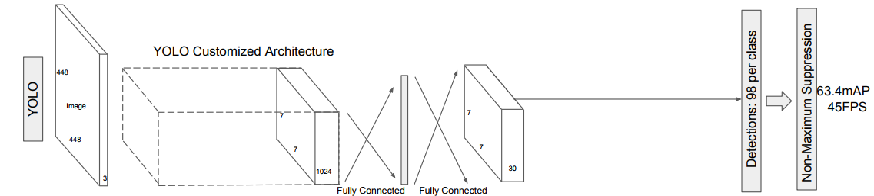
yolo
point x,y bbox w,h
Confidence
=5
Convs
class (20)
flatten
Per grid
= 2
3x3x30
Maxclass ‘car’
*
loc
softmax
BoxReg

Slide 24
SSD
Classic model (VGG residual)
convs
32,32,num_anchors * (num_classes + 1 )
1.classification = object_class+1(background)
2.muti scale detection
softmax
Output channels =
num_anchors * (num_classes + 1 )
1,64,32,32
4096 defalutbox
BoxReg
Ouput channel =
num_anchor box * 4
Default box
Class = 2
…
4160,4
32,32, num_anchor box * 4
Convs
Pred class
…
1,128,4,4
64 defalutbox
softmax
4160,3
BoxReg
Gt class
1,3
Output default box = (4160,4)
Output class = (4160,3) Output bbox = (16640)
Bouning box
(1,4)
Notes:
Downsample default box size increase
4160 small region for predict vs classification => once predict

Slide 25
Yolov2 *(training strategy
label
Target
layer
Input = (4,3,448,448)
Feature
extraction
Predict
layer
Forward
layer
cls
sc
loss
Class
Score
xywh
xywh
output = (4,176,13,13)
With anchor box

Slide 26
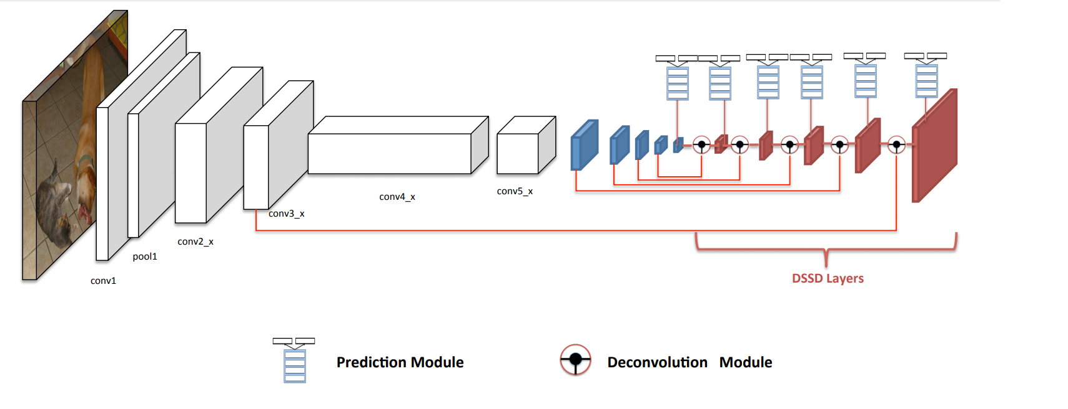
DSSD
Resnet 18 use pretrain model
Resblock
downsample

Slide 27
Take home message
ResNet,SSD, deconvolution layer
Further improve
1. better feature network
(VGG vs ResNet , performance is similar if the input image is small)
2.adding more context for small object
(elementwise product vs elementwise sum)
(don’t see improvements on large object)
3.how to maintaining comparable speed
4.new output module

Slide 28
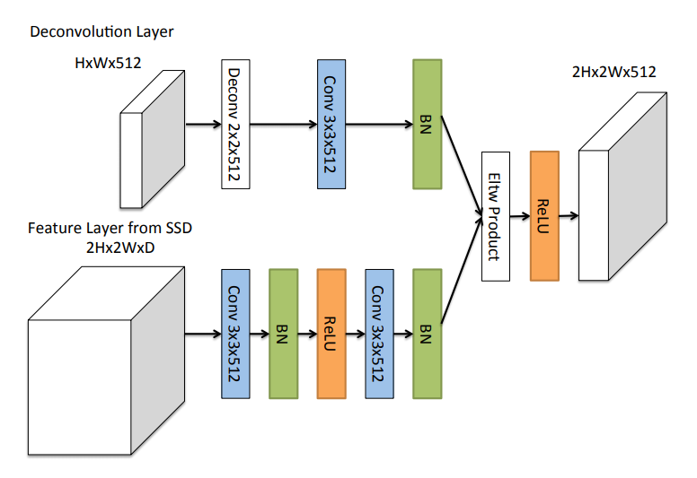
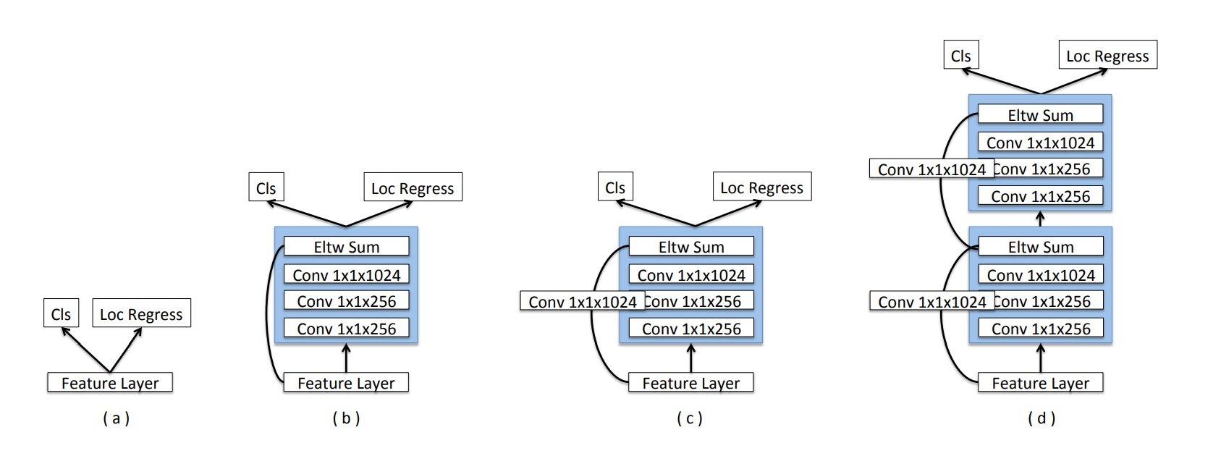
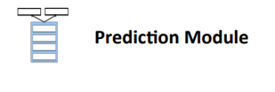
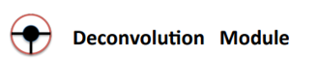
Predcit Module and Deconvolution Module
MS-CNN point out that improving
the sub-network of each task can
Improve accuracy
MS-CNN (ECCV 2016)
Applied deconv on multiple layers of a ConvNet
To increase feature map resolution before using
Layers to learn region proposals and pool feature
Using deconv layers and
skip connection can inject
more semantic feature
Combined feature map short coming
1.Memory footprint
2.Decrease the speed

Slide 29
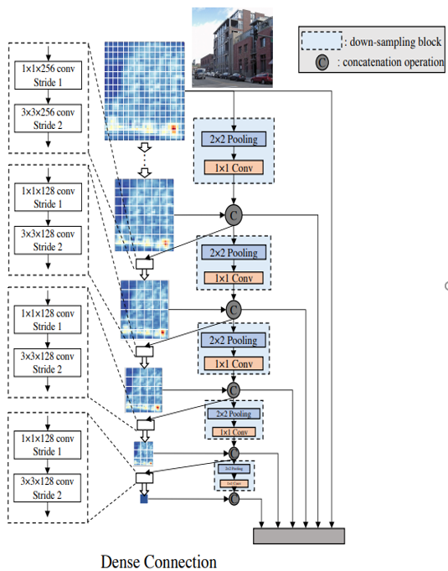
Intermission
Yolo
Faster rcnn
R-CNN
tradition
SSD
Retina net
DSSD

Slide 30
DSOD
The proposed DSOD method is a multi-scale proposal-free detection framework similar to SSD
network structure of DSOD can be divided into two parts:
the backbone sub-network for feature extraction
the front-end sub-network for prediction over multi-scale response maps.

Slide 31
DSOD-predict layer
After feature extraction feature map size
Anchor_scale num=2
Class_num = 2
Output channels =
num_anchors * (num_classes + 1 )
intput = (4,1568,19,19)
19*19*2*3 = 2166
Anchor_size=[[0.8,0.6]]
Anchor_ratio =[[1,2,0.5]]
Class_num =2
19*19*2*4 = 2888
Ouput channel =
num_anchor box * 4
Predict
layer

Slide 32
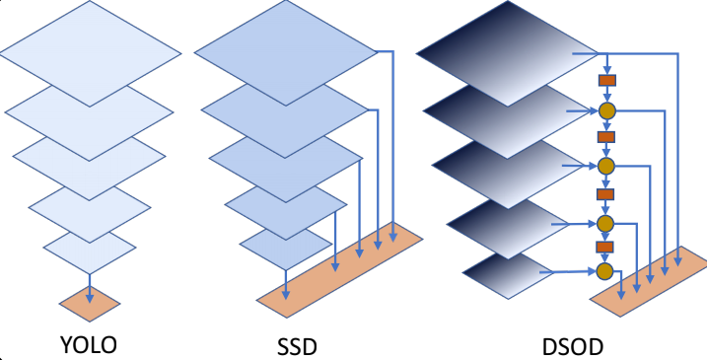
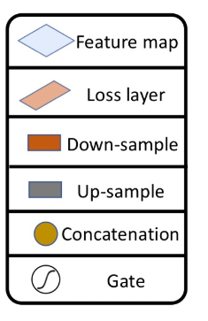
YOLO, SSD, DSOD

Slide 33
principle
1. proposal free
2. Deep supervision
3. stem block

Slide 34
Principle1 : proposal-free
three categories:
R-CNN and Fast R-CNN require external object proposal generators like selective search.
Faster R-CNN and R-FCN require integrated region-proposal-network (RPN) to generate relatively fewer region proposals
YOLO and SSD are single-shot and proposal-free methods, which handle object location and bounding box coordinates as a regression problem.

Slide 35
Prosposal free
We observe that only the proposal-free method can converge successfully without the pre-trained models.
We conjecture this is due to the RoI (Regions of Interest) pooling in the other two categories of methods.
RoI pooling generates features for each region proposals, which hinders the gradients being smoothly back-propagated from region-level to convolutional feature maps.
In practice, we derive a multi-scale proposal-free framework from the SSD framework ，as it could reach state of-the-art accuracy while offering fast processing speed。

Slide 36
Key Findings (training from scratch)
Faster RCNN & R-FCN: < 15% mAP on VOC without the pre-trained models.
SSD: 69.6% mAP on VOC.

Slide 37
Principle 2: deep supervision
The central idea is to provide integrated objective function as direct supervision to the earlier hidden layers, rather than only at the output layer.
The proposal-free detection framework contains both classification loss and localization loss.
earlier layers in DenseNet can receive additional supervision from the objective function through the skip connections. Although only a single loss function is required on top of the network, all layers including the earlier layers still can share the supervised signals unencumbered.

Slide 38
Transition w/o pooling layer
We introduce this layer in order to increase the number of dense blocks without reducing the final feature map resolution.
if one wants to maintain the same scale of outputs. The only way to increase network depth is adding layers inside each block for the original DenseNet

Slide 39
Principle 3: stem block
we define stem block as a stack of three 3×3 convolution layers followed by a 2×2 max pooling layer.
We find that adding this simple stem structure can evidently improve the detection performance in our experiments.
the stem block can reduce the information loss from raw input images.

Slide 40
Principle 4: dense prediction structure
The Scale-1 feature maps are from the middle layer of the backbone subnetwork, which has the largest resolution (38×38) in order to handle the small objects in an image

Slide 41
Learning Half and Reusing Half
in SSD each later scale is directly transited from the adjacent previous scale. We propose the dense structure for prediction, which fuses multi-scale information for each scale.
half of the feature maps are learned from the previous scale with a series of conv-layers, while the remaining half feature maps are directly down-sampled from the contiguous high-resolution feature maps

Slide 42
Learning Half and Reusing Half
The pooling layer is placed before the 1×1 conv-layer for the consideration of reducing computing cost
For each scale, we only learn half of new feature maps and reuse the remaining half of the previous ones. This dense prediction structure can yield more accurate results with fewer parameters than the plain structure.

Slide 43
Experiments
PASCAL VOC 2007, 2012 and MS COCO datasets that have 20, 20, 80 object categories respectively. Object detection performance is measured by mean Average Precision (mAP).

Slide 44
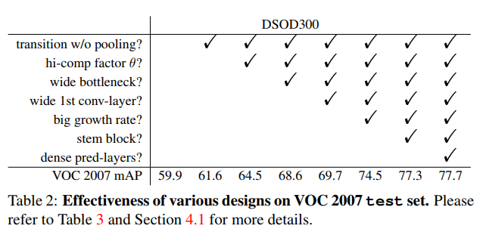
Ablation Study on PASCAL VOC2007
More parameters

Slide 45
Effectiveness of Design Principles
Proposal-free Framework:
We tried to train object detectors from scratch using the proposal-based framework such as Faster R-CNN and R-FCN. However, the training process failed to converge for all the network structures we attempted (VGGNet, ResNet, DenseNet).
We further tried to train object detectors using the proposal-free framework SSD. The training converged successfully but gives much worse results (69.6% for VGG), compared with the case fine-tuning from pre-trained model (75.8%), This experiment validates our design principle to choose a proposal-free framework.

Slide 46
Deep supervision
Deep Supervision:
We then tried to train object detectors from scratch with deep supervision. Our DSOD300 achieves 77.7% mAP, which is much better than the SSD300S that is trained from scratch using VGG16 (69.6%) without deep supervision. It is also much better than the fine-tuned results by SSD300 (75.8%).

Slide 47
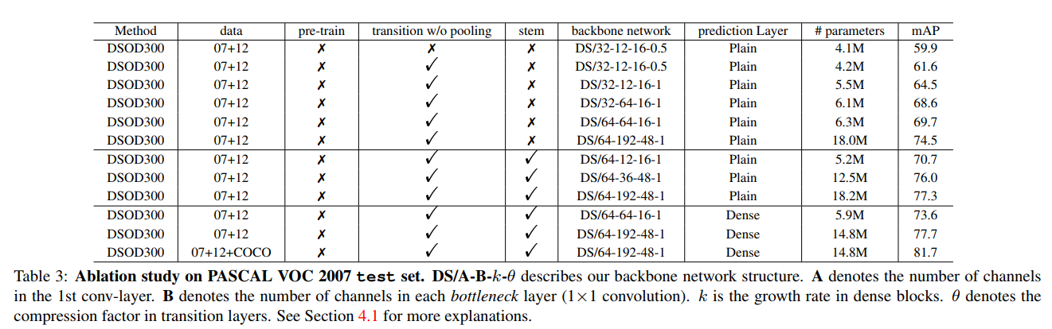
Transition w/o Pooling Layer
DS/A-B-K-theta
A = num of channel in 1st conv
B = num of channel in each bottle neck
K = growth rate
Theta = factor in layer
The network structure with the Transition w/o pooling layer brings 1.7% performance gain, which validates the effectiveness of this layer.

Slide 48
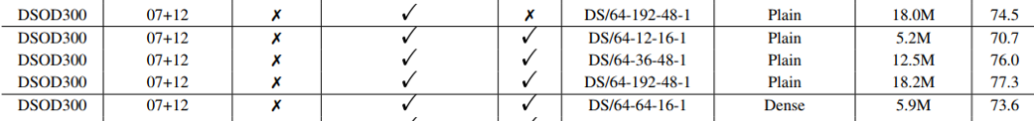
Stem Block

Slide 49
Dense prediction structure
We analyze the dense prediction structure from three aspects: speed, accuracy and parameters.
DSOD with dense front-end structure runs slightly lower than the plain structure
=>due to the overhead from additional down-sampling blocks
the dense structure improves mAP from 77.3% to 77.7%, while reduces the parameters from 18.2M to 14.8M
We also tried to replace the prediction layers in SSD with the proposed dense prediction layers. The accuracy on VOC 2007 test set can be improved from 75.8% (original SSD) to 76.1% (with pre-trained models), and 69.6% to 70.4% (w/o pre-trained models), when using the VGG-16 models as backbone.

Slide 50
What if pre-training on ImageNet?
It is interesting to see the performance of DSOD with backbone network pretrained on ImageNet.
We trained one lite backbone network DS/64-12-16-1 on ImageNet, which obtains 66.8% top-1 accuracy and 87.8% top-5 accuracy on the validationset (slightly worse than VGG-16).
After fine-tuning the whole detection framework on “07+12” trainval set, we achieve 70.3% mAP on the VOC 2007 test-set.
The corresponding training-from-scratch solution achieves 70.7% accuracy, which is even slightly better

Slide 51
Runtime Analysis
With 300×300 input, our full DSOD can process an image in 48.6ms (20.6 fps) on a single Titan X GPU with the plain prediction structure, and 57.5ms (17.4 fps) with the dense prediction structure.
As a comparison, R-FCN runs at 90ms (11 fps) for ResNet-50 and 110ms (9 fps) for ResNet-101. The SSD300∗ runs at 82.6ms (12.1 fps) for ResNet-101 and 21.7ms (46 fps) for VGGNet.
about only 1/2 parameters to SSD300 with VGGNet,
1/4 to SSD300 with ResNet-101,
1/4 to R-FCN with ResNet-101
1/10 to Faster R-CNN with VGGNet.
A lite-version of DSOD (10.4M parameters, w/o any speed optimization) can run 25.8 fps with only 1% mAP drops.

Slide 52
Results on PASCAL VOC2007
Dataset : VOC 2007 trainval and VOC 2012 trainval (“07+12”)
Batchsize : 128 (8GPU server ,each with 12GB memory)
Learning rate: 0.1(init) ,an then divided by 10 after every 20K iteration
Init : with “xavier”
Result:
DSOD (plain): 77.3%
SSD* :77.2%
DSOD (dense): 77.7 ,Adding COCO as training data : 81.7%

Slide 53
Result on Pascal VOC 2012
Dataset : VOC 2007 (all) and VOC 2012 trainval (“07+12”)
Batchsize : 128 (8GPU server ,each with 12GB memory)
Learning rate: 0.1(for the first 30K) ,an then divided by 10 after every 20K iteration (110K)
Init : with “xavier”
Result:
DSOD (dense): 76.7

Slide 54
Result on MS COCO
Dataset : 80K for training 40K validation 20K for trsting (training data: train + val)
Batchsize : 128 (8GPU server ,each with 12GB memory)
Learning rate: 0.1(for the first 80K) ,an then divided by 10 after every 60K iteration (320K)
Init : with “xavier”
Result:
achieves: 29.3% / 47.3% outperforms the baseline SSD300∗ with a large margin

Slide 55
Interestingly, we observe that our result with 0.5 IoU is lower than R-FCN,
but our [0.5:0.95] result is better or comparable.
This indicates that our predicted locations are more accurate than R-FCN under the larger overlap settings.
It is reasonable that our small object detection precision is slightly lower than R-FCN since our input image size (300×300) is much smaller than R-FCN’s (∼ 600×1000). Even with this disadvantage, our large object detection precision is still much better than R-FCN.

Slide 56
Discussion
Better Model Structure vs. More Training Data:
Computer vision tasks might be solved with deeper and larger neural networks backed with massive training data like ImageNet
We definitely agree that, under modest assumptions that given boundless training data and unlimited computational power, deep neural networks should perform extremely well.
our DSOD is only trained with 16,551 images on VOC 2007, but achieves competitive or even better performance than those models trained with 1.2 million + 16,551 images.
training deep neural networks becomes more and more expensive. Thus a simple yet effi- cient approach becomes increasingly important.

Slide 57
Why training from scratch
First, there may be big domain differences from pretrained model domain to the target one. It is very difficult to transfer ImageNet model to the domains of depth images, multi-spectrum images, medical images.
what an amazing thing if we have a technique which can train object detector from scratch. Second, model fine-tuning restricts the structure design space for object detection networks. This is very critical for the deployment of deep neural networks models to resource-limited Internet-of-Things (IoT) scenario

Slide 58
Model Compactness vs. Performance
It has often been reported that there is a trade-off between model compactness (in terms of the number of parameters) and performance.
our smallest dense model achieves 73.6% mAP with only 5.9M parameters, which shows great potential for applications on low-end devices.

Slide 59
Conclusion
presented Deeply Supervised Object Detector (DSOD), a simple yet efficient framework for training object detector from scratch. Without using pre-trained models on ImageNet

Slide 60

Matching strategy
For each ground truth box we are selecting from default boxes that vary over location, aspect ratio, and scale.
We begin by matching each ground truth box to the default box with the best jaccard overlap
we then match default boxes to any ground truth with jaccard overlap higher than a threshold (0.5). allowing the network to predict high scores for multiple overlapping default boxes rather than requiring it to pick only the one with maximum overlap
Notes:
Intersection of union
除了選最像的 >0.5 也選起來 當positive

Slide 61
Hard negative mining
most of the default boxes are negatives, especially when the number of possible default boxes is large
we sort them using the highest confidence loss for each default box and pick the top ones so that the ratio between the negatives and positives is at most 3:1

Slide 62
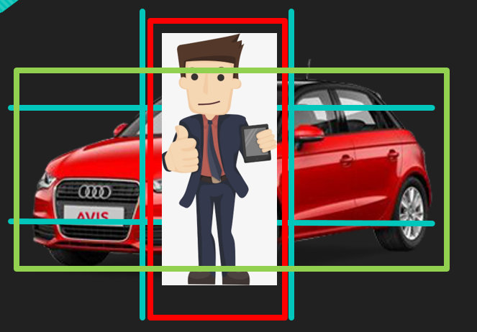
Anchor box with matching strategy
image
CNN
16x16
map
Why anchor box with differnet ratio
16x16
map

Slide 63
Forward path ( prediction map)
data structure
16x16
anchorbox1
anchorbox2
map
Class
pred
score
xy
wh
Class
pred
score
xy
wh
2
1
2
2
2
1
2
2
Slice it to cid, score, xywh froamt
map

Slide 64
How to match
16x16
Choose the Best( or greater than thresholding)
overlap for each target with anchor box
map
Number of anchor = 16 x16 x2 = 512
After best matching => 1 : 511
Target
Match => anchor 1

Slide 65
Target to matrix
Create four matrix:
Cls_id = ones( [num_batch, w, h, n, 1] ) * -1 ( ignore_label)
Score = zeros( [num_batch, w, h, n, 1] )
Box = zeros( [num_batch, w, h, n, 4] )
Sample_weight = zeros( [num_batch, w, h, n, 1])
Target = [ 1 , 0.2, 0.3, 0.5, 0.7]
Cls_id
box
16x16
map
Cls_id [num_batch, 6, 11, 0, :] = 1
box [num_batch, 6, 11, 0, :] = [0.2, 0.3, 0.5, 0.7]
Score matrix
Sample
weight
Marker (6,11)
Score_matrix[num_batch, 6, 11, 0, :] = 1
Sample_weight [num_batch, 6, 11, 0, :] = 1

Slide 66
Loss
Class
Cross_entropy (cls_pred, tls, sample_weighing * cls_weighting)
Score
Score_weighting(sample_weighting > 0 ,*5 , * 0.05)
L1 ( score_pred, tscore, score_weighting)
Bbox_reg
Box_weighting( sample_weighting * box_weighing)
L1( box_pred, tbox, box_weighting)
loss

